Slide 1
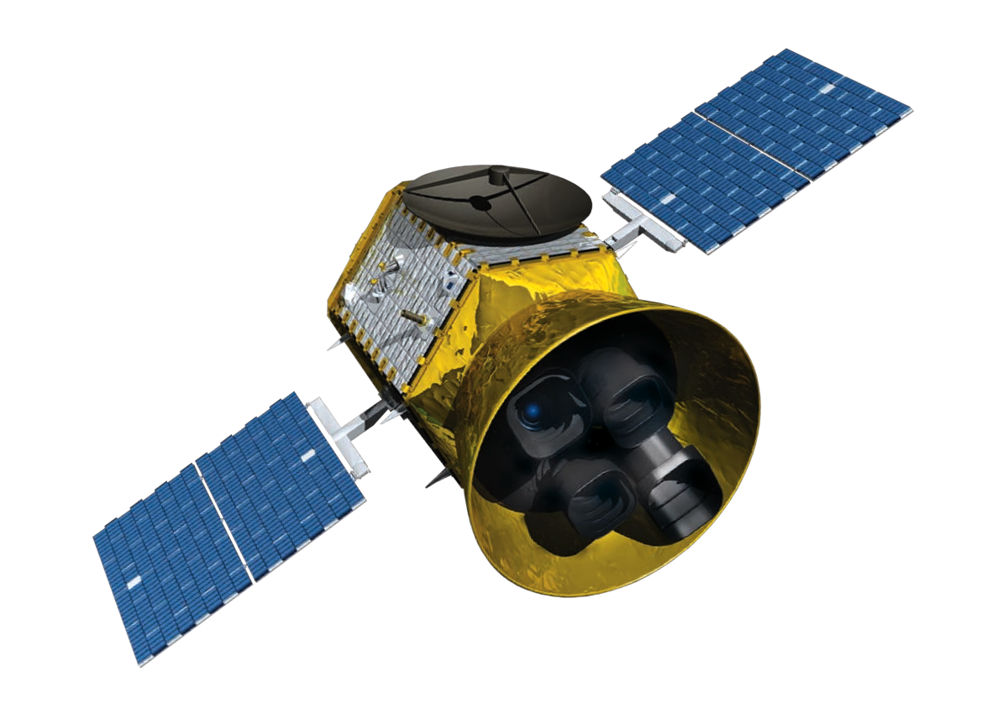




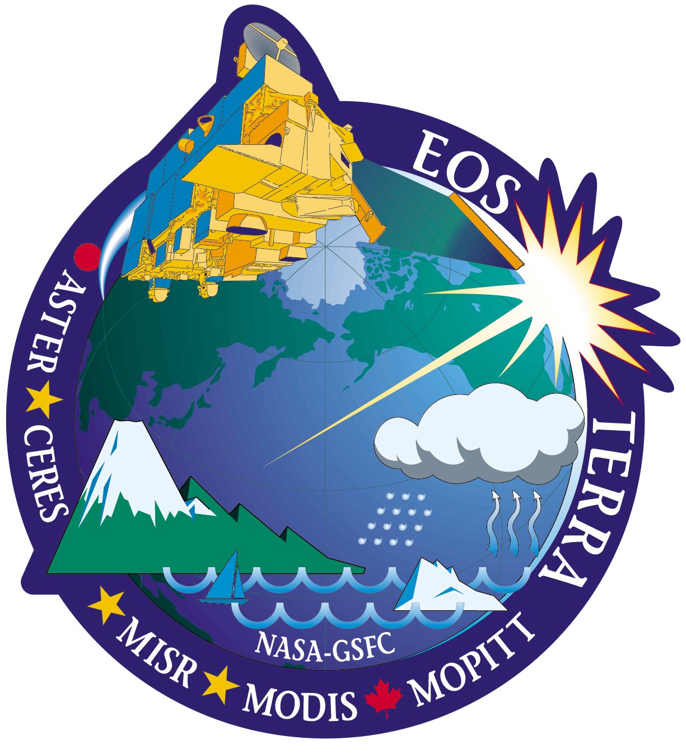

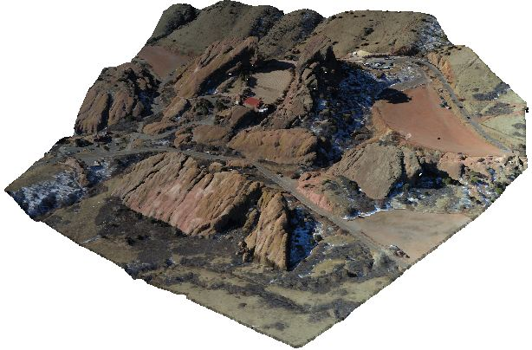
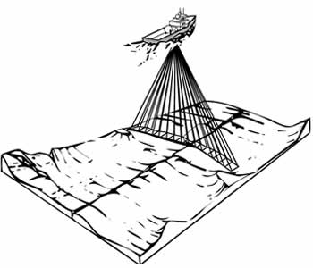
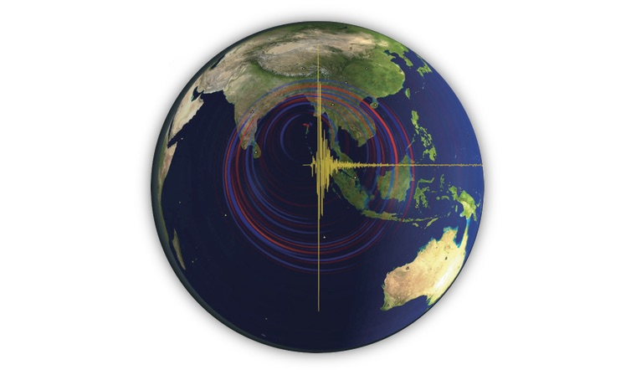
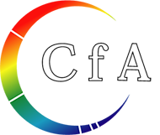

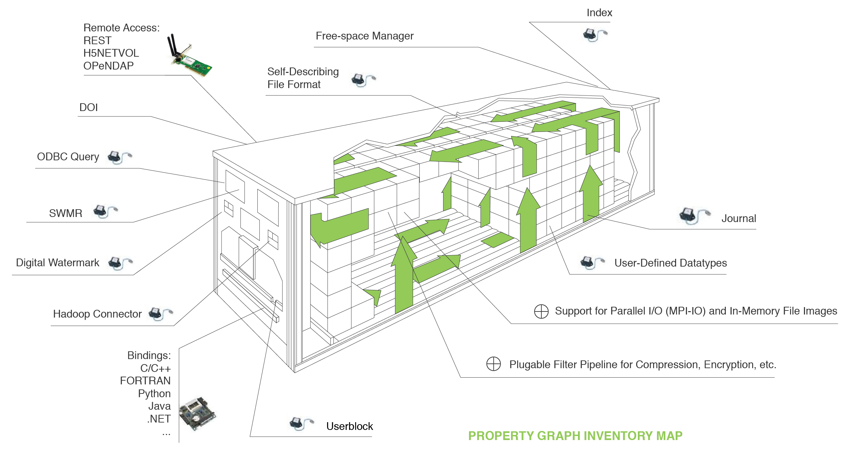
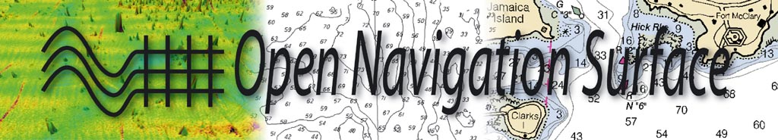
The HDF Data Format: High Performance Interoperability for Earth Science Communities
Sean Gordon (scgordon@hdfgroup.org), Ted Habermann, and John Kozimor, The HDF Group. Lindsay Powers, USGS
IN23C-1780
Communities customize HDF by creating metadata and data structure conventions for describing datatypes that are specific to their domain. HDF is foundational to storing, sharing, and reusing data from these communities.
HDF Communities
Earth Observation
Atmospheric Science and Oceanography
Seismology
Community Conventions
Planetary science
HDF-EOS
Swaths
Multi-dimensional Grids
Zonal averages
Points
NetCDF / CF
Multi-dimensional Grids
Discrete Sampling Features
Ecology
ASDF
hydrography
FITSinHDF
Imagery
NEON HDF5
Point Clouds
BAG
Tabular metadata
Annotations
Grids
Property Graph inventory map of HDF
Notes:
Datatypes: Swaths, time, series grids. IDL
Common framework
Community conventions are important as they provide a convention to describe datatypes that are specific to their domain
Communities use hdf by creating metadata and data structure conventions describing datatypes that are specific to their domain
Communities customize HDF by creating metadata and data structure conventions for describing datatypes that are specific to their domain
Add qcode poster number
Consider adding matlab is a tool that uses hdf as a format .mat wrapper around hdf

